Slide 1

Streamflow and Groundwater Conditions in Rhode Island
September 2022
Gardner Bent
U.S. Geological Survey
New England Water Science Center
Notes:
Image 01117800 Wood River near Arcadia from 10/05/2022

Slide 2
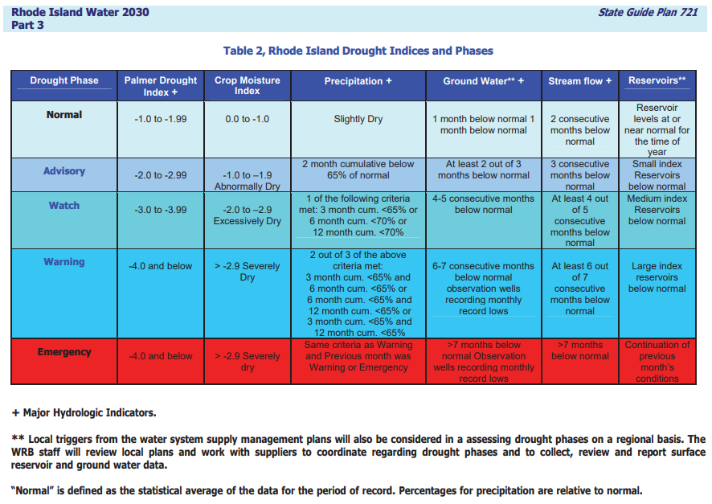


Slide 3
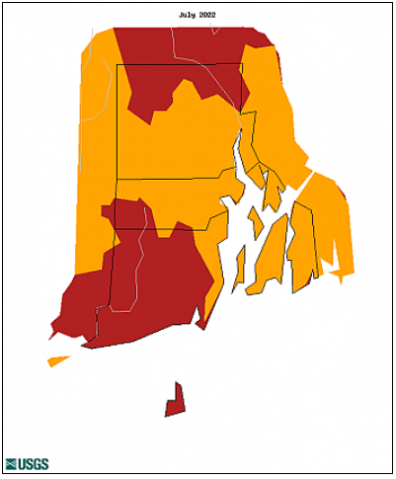
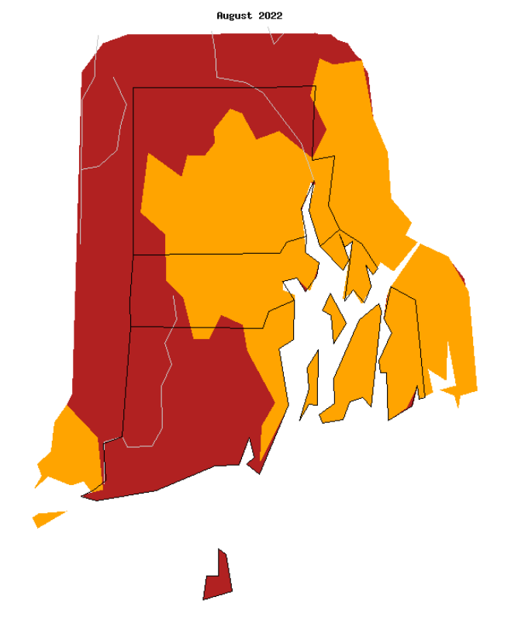
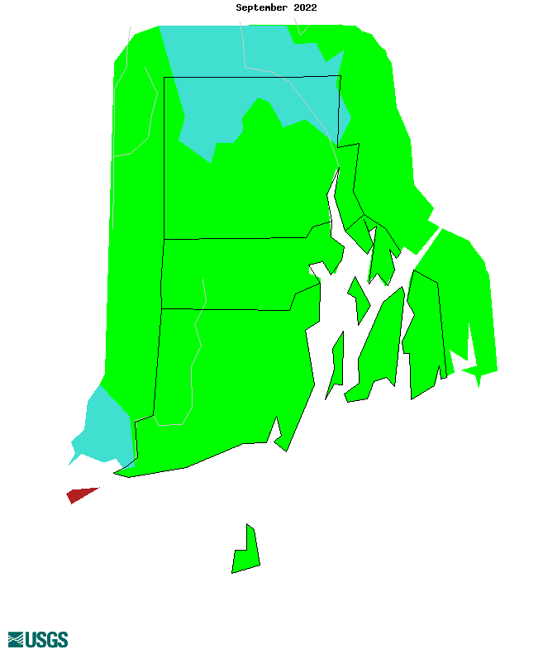
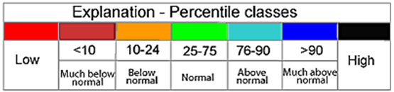
Average Monthly Streamflow Conditions
July - September
July
August
September

Slide 4
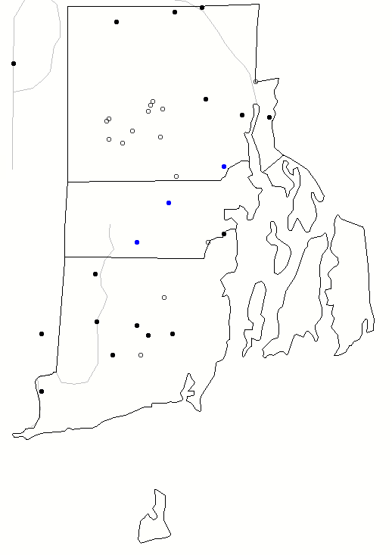
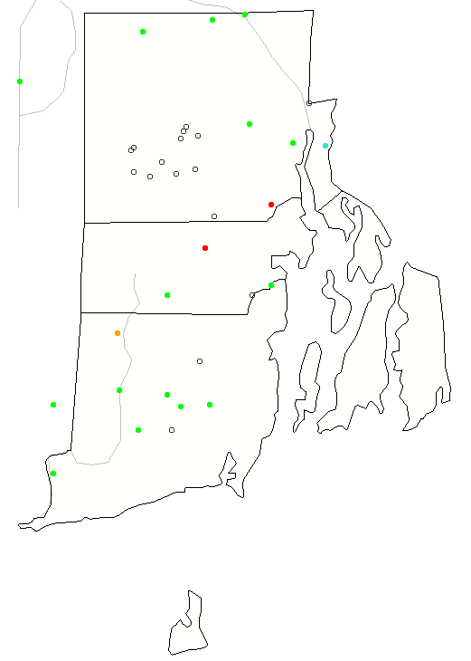

7 - Day Maps
September 08, 2022
September 30, 2022
Notes:
First week of September vs last week of September –
7 day stream flow vs that day of year for the period of record.

Slide 5
Region Average Percentages
Regions | Q 3/2022 | Q 4/2022 | Q 5/2022 | Q 6/2022 | Q 7/2022 | Q 8/2022 | Q 9/2022
Northwest | 66 | 36 | 3 | 21 | 19 | 2 | 81
Northeast | 59 | 38 | 11 | 9 | 9 | 3 | 76
Central West | 25 | 40 | 10 | 28 | 23 | 49 | 43
Central East | 56 | 42 | 6 | 11 | 19 | 14 | 46
Eastern | No Gages--------------------------------------------------------------------------------------
Southern | 57 | 31 | 17 | 30 | 14 | 10 | 36
New Shoreham | No Gages--------------------------------------------------------------------------------------
 | March 2022 | April 2022 | May 2022 | June 2022 | July 2022 | August 2022 | September 2022
statewide Q | 55 | 35 | 13 | 23 | 16 | 11 | 48
*Pawcatuck at Wood River Junction:
March=61%, April =41%, May=23%,
June=25%, July=6%, August=2%,
September=22%
Notes:
Streamflow = Advisory (Three consecutive months below 25%)
Looking at past 5 months to show full situation

Slide 6
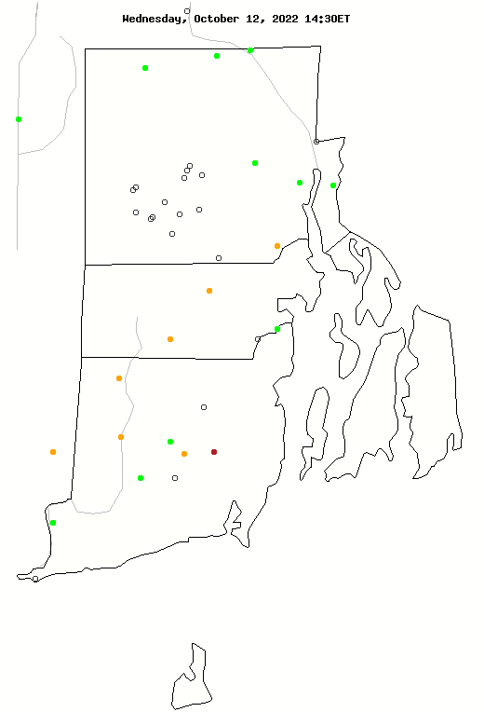
Current Streamflow Conditions – October 12, 2022
Notes:
State this is an average daily flow map compared to all other 10/12/2022 in history.
The circled gages are what will be shown is the following slides going from north to south

Slide 7
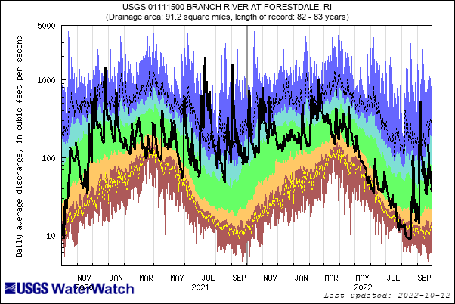

Notes:
01111500
Graph generated on 10/12/2022
2 year plot

Slide 8
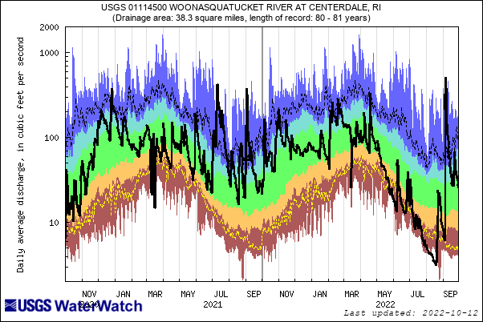
Notes:
01114500
Graph generated on 10/12/2022
2 year

Slide 9
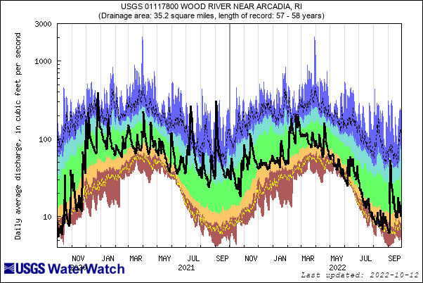
Notes:
01117800
Graph generated on 10/12/2022
2 year

Slide 10
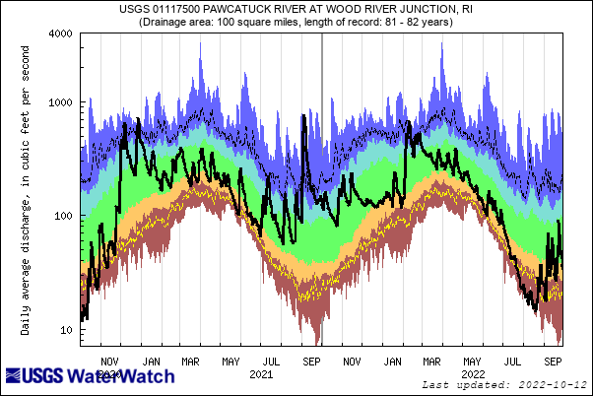
Notes:
Describe this what this shows, go over the what percents are normal ect…
01117500
Graph generated on 09/08/2022
2 year daily plot

Slide 11
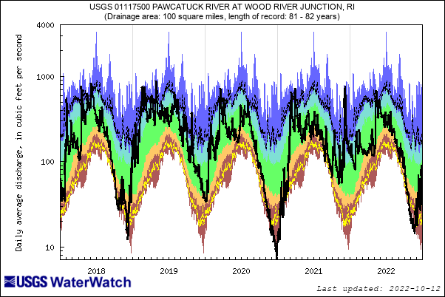
Notes:
01117500
Graph generated on 10/12/2022
5 year daily plot

Slide 12
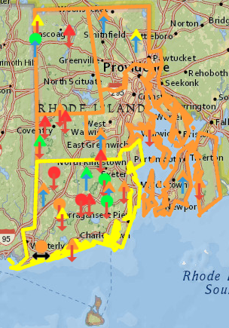
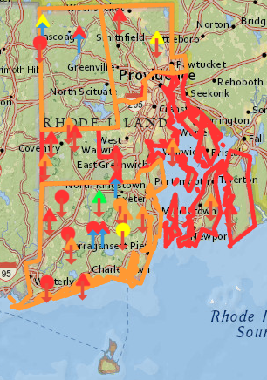
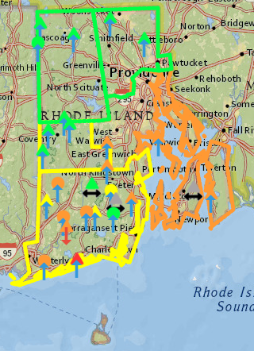
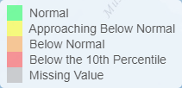
Groundwater Conditions
End of July 2022
End of August 2022
End of September 2022
Notes:
Images from RI WRB Drought dashboard
Triangles are discreet once a month WL meas. And Circles are continuous wells
Upward arrows GW levels up since last month

Slide 13
Average Groundwater Conditions
Advisory (two out of past three months below 25%)
Regions | GW 3/2022 | GW 4/2022 | GW 5/2022 | GW 6/2022 | GW 7/2022 | GW 8/2022 | GW 9/2022
Northwest | 52 | 43 | 19 | 31 | 22 | 13 | 60
Northeast | 31 | 52 | 12 | 16 | 24 | 19 | 81
Central West | 35 | 31 | 10 | 27 | 14 | 7 | 35
Central East | 41 | 32 | 14 | 20 | 20 | 9 | 19
Eastern | 33 | 37 | 17 | 15 | 17 | 9 | 11
Southern | 55 | 44 | 33 | 30 | 26 | 17 | 30
New Shoreham | No Wells-------------------------------------------------------------------------------------------
 | March 2022 | April 2022 | May 2022 | June 2022 | July 2022 | August 2022 | September 2022
statewide GW | 47 | 41 | 24 | 27 | 22 | 14 | 38
Notes:
Groundwater = Advisory (Two out of past three months below 25%)

Slide 14
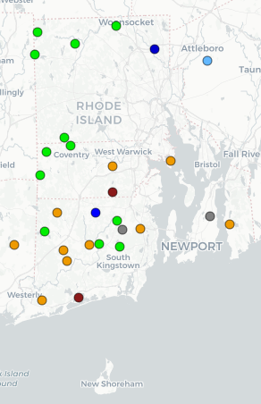
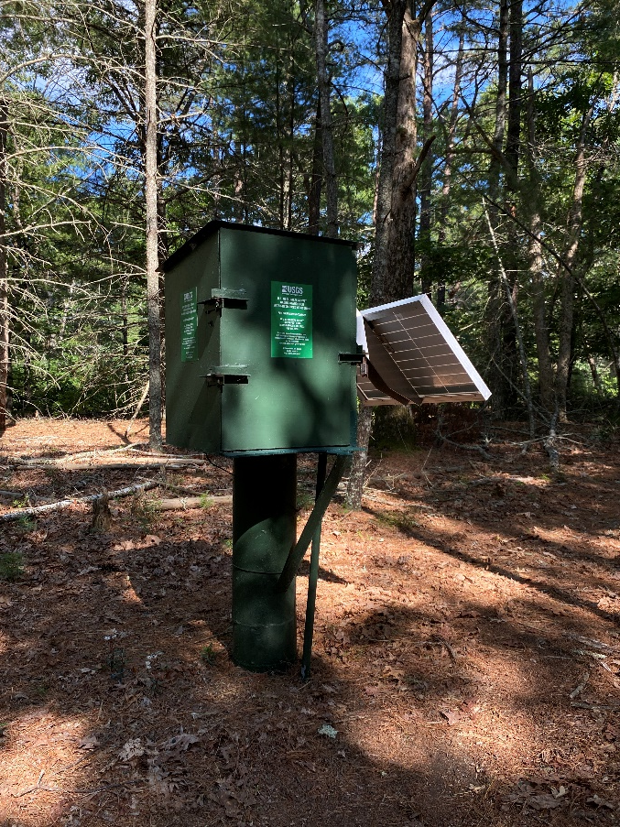
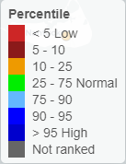
Current Groundwater Conditions
October 12, 2022
Notes:
The circled gages are what will be shown in the following slides starting in the north and going south

Slide 15
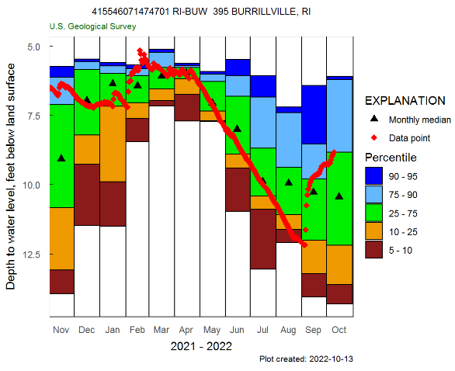
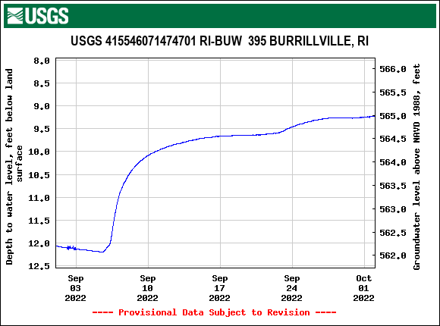
Notes:
BUW 395 Burrillville, RI

Slide 16
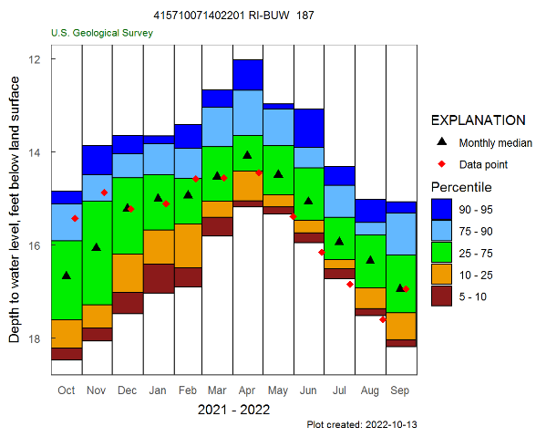
Notes:
BUW 187 – Burrillville, RI

Slide 17
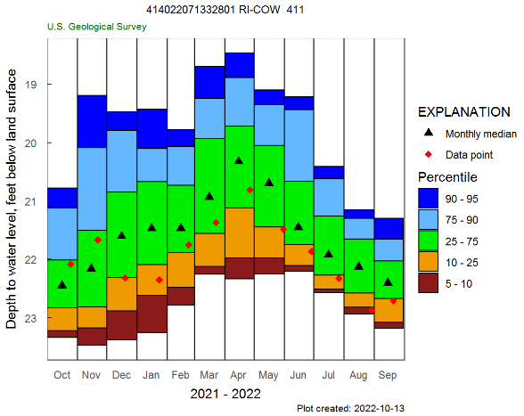
Notes:
COW 411 – Coventry

Slide 18
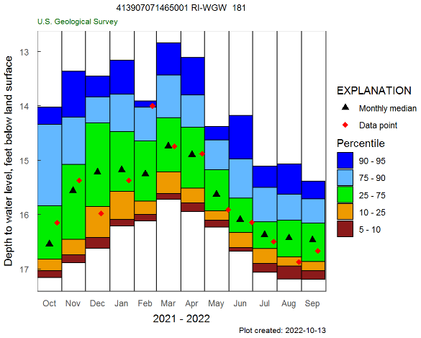
Notes:
WGW 181 – West Greenwich

Slide 19
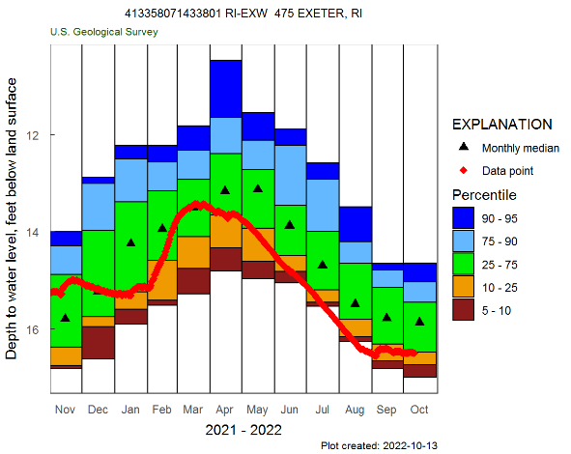
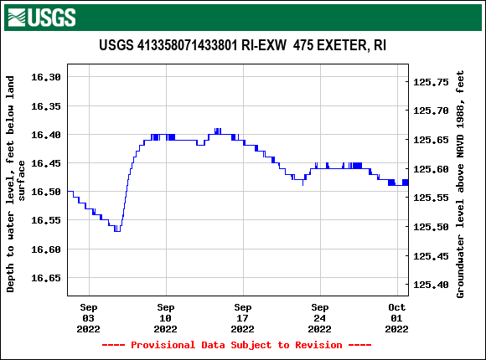
Notes:
EXW 475 – Exeter

Slide 20
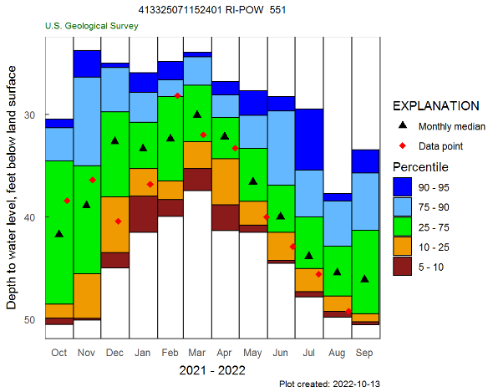
Well measured on Sept. 21,2022 and was dry
Notes:
POW 551 – Portsmouth

Slide 21
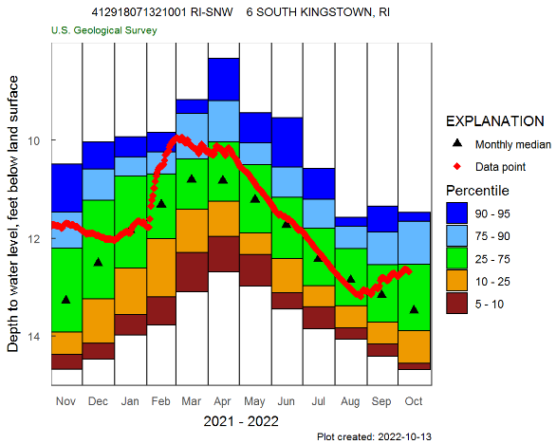
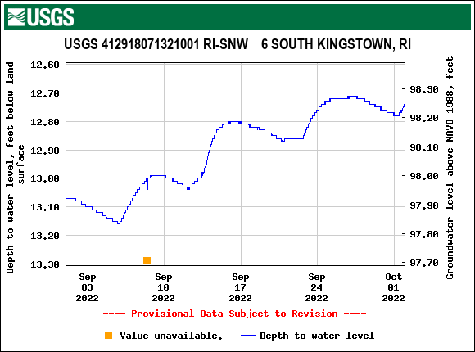
Notes:
SNW 6 – South Kingstown

Slide 22
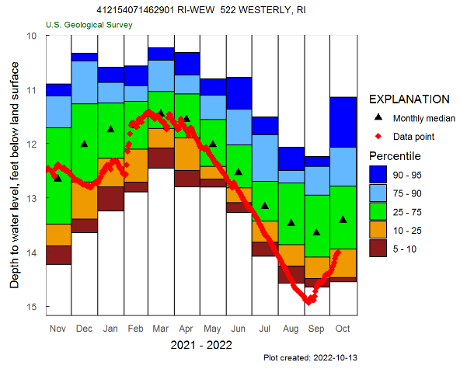
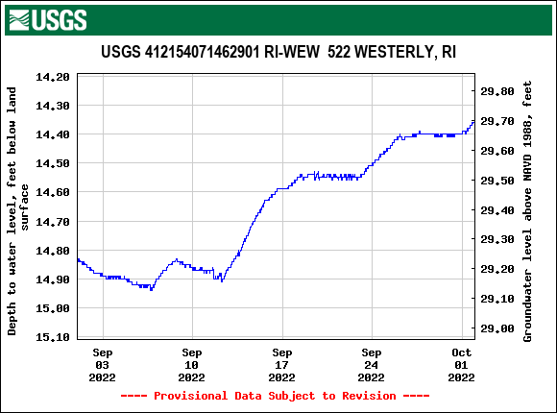
Notes:
WEW 522 – Westerly

Slide 24
Statewide Summary: Streamflow - Recap
Based on the State Guide Plan 721
  Drought advisory calls for 3 consecutive months of below-normal streamflow
    July 16%
    August 10%
    September 48%
  Streamflow returned to normal conditions in September, so State is Normal
Notes:
Use Tim’s slides

Slide 25
Statewide Summary: Groundwater - Recap
Based on the State Guide Plan 721 there
  Drought advisory calls for only 2 of past 3 months of below normal groundwater levels
    July 22%
    August 14%
    September 38%
  Groundwater levels returned to Normal in most drought regions in September, but Statewide the Advisory remains

Slide 26
Questions?
Notes:
01117000 06/30/2022

